Slide 1
UN Network of Economic Statisticians 5 April 2022 Household Satellite Account and Time-use in the UK Gueorguie Vassilev – Head of Skills, Time-Use and Economic Well-being, UK

Slide 2
Contents
What is valued
What are international recommendations
UK Online Time-Use Survey
What is still needed to go from a time-use survey to a household satellite account
Other aspects of time-use and well-being

Slide 3
UK Household Satellite Account
Type of service | Method
Voluntary activity | Input
Adult care | Input
Childcare | Output
Laundry | Output
Clothing | Output
Nutrition | Output
Transport | Output
Household housing services | Input

Slide 4
International guidance context
Categories:
Methodology:
SNA production boundary
Methods: Input / production or Output with time-use at core
Capital assets for consumption of fixed capital
Supply-Use tables
Time-use surveys:
Attempts at harmonisation – ICATUS/HETUS
Modernisation
Accessibility and quality
Unpaid household service work grouping – ISWGNA 2021
Childcare
Adult care
Nutrition
Transport
Household management services
Laundry and clothing services
Informal volunteering
Shopping
Information services
Other
Notes:
2017 guide: https://unece.org/fileadmin/DAM/stats/publications/2018/ECECESSTAT20173.pdf UK chaired the creation of this guide
2021 guidance note: https://unstats.un.org/unsd/nationalaccount/RAdocs/WS3_Unpaid_HH_Service_Work_Paper.pdf UK chaired the creation of this guidance note

Slide 5
UK Online Time-Use Survey
Developed online collection tool:
initial questionnaire
diary days
post-diary-day questionnaire
4 waves collected (as of March 2022)
Planned future wave expanding to capture location, and focus on relationship with human capital acquisition
Intention for more regular collection going forward

Slide 6
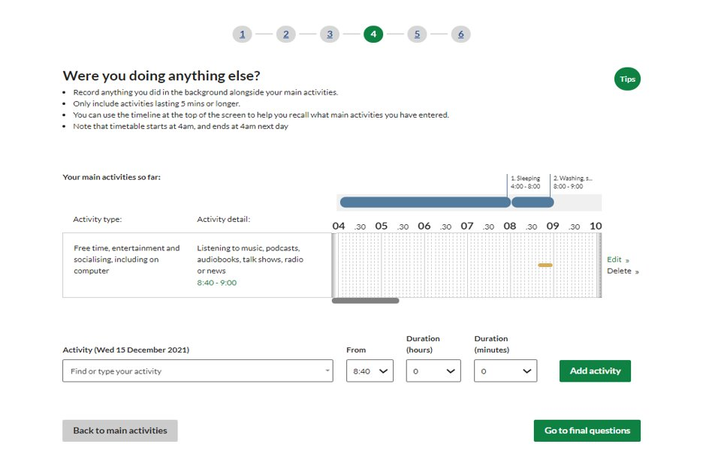
UK Online Time-Use Survey

Slide 7
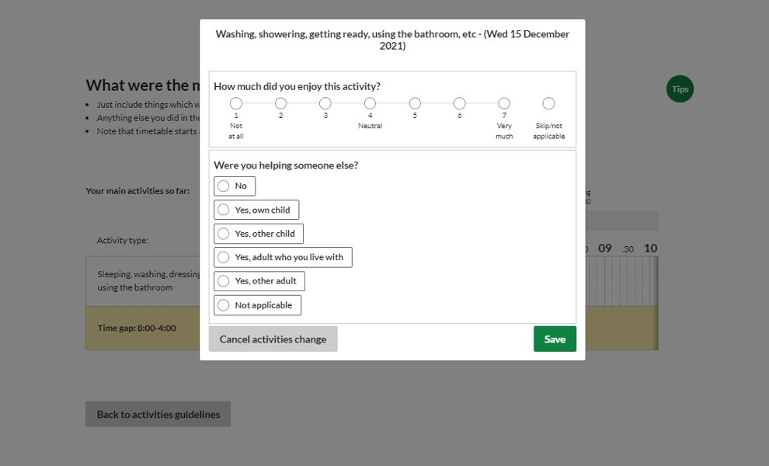
UK Online Time-Use Survey

Slide 8
UK Online Time-Use Survey results

Slide 9
UK Online Time-Use Survey results

Slide 10
Further steps to satellite account
Complete Scope
Self-classification of internet services
Supervisory children’s and adult care
Consistent pricing and intermediate consumption
Combine spending and time-use diaries
Willingness to pay/lose or outcome description through questionnaire
Quality adjustments for ‘real’ estimation
Need to bring together household capital assets
Need to consider conceptual relationship to human and natural capital

Slide 11
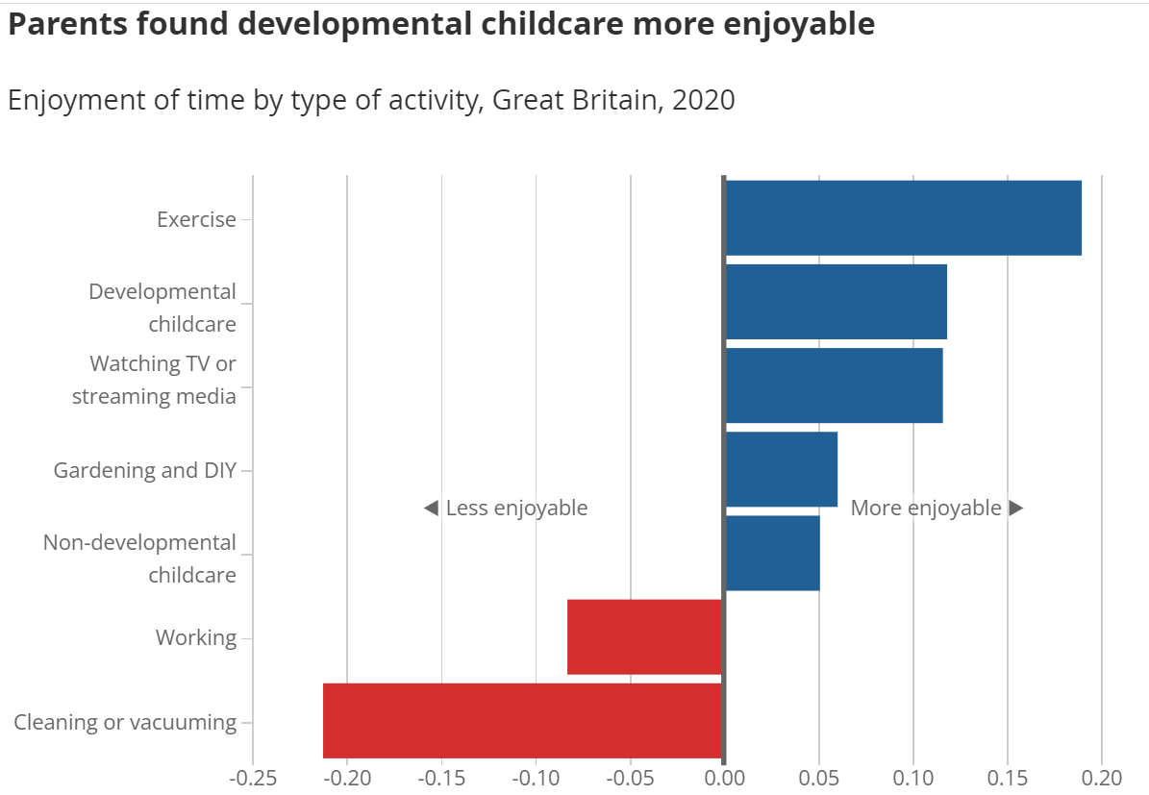
Time-Use + Well-being
Leisure valuation
Activity enjoyment levels
Time-use differences across demographics

Slide 12
Summary
UK Household Satellite Account - core valuation
UK Online Time-Use Survey - way forward for unpaid work measurement
Other time-use surveys benefits for well-being analysis
Evolution of scope of unpaid household work
Interesting outstanding conceptual questions on further gaps
Contact: economic.wellbeing@ons.gov.uk

